Slide 1

Two in the Pool Effect

Slide 2

decoy
effect
Notes:
A research professor who’s work focuses on the intersection of leadership and diversity was inspired by a common marketing principle and product pricing strategy.
The Decoy Effect also known as the Asymmetric Dominance Effect is a cognitive bias in which consumers will tend to have a specific change in preferences between two options when also presented with a third option that is asymmetrically dominated.

Slide 3

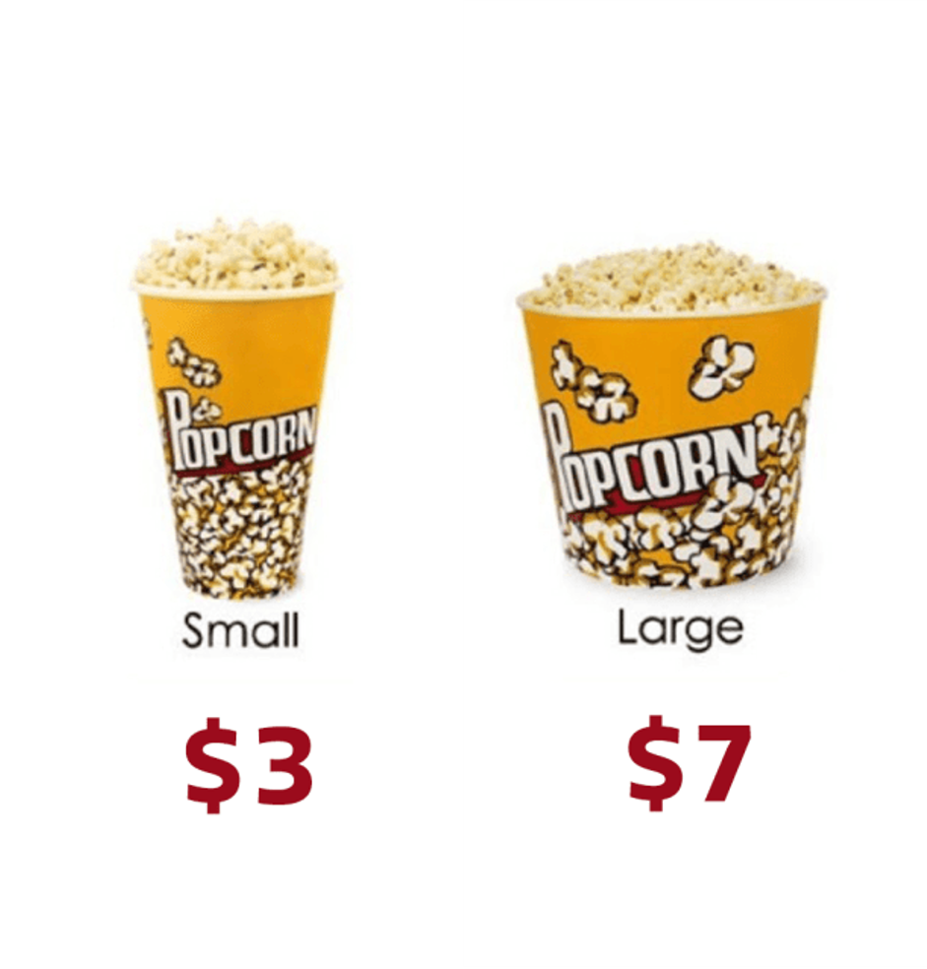
Notes:
A classic example of the decoy effect may found at the concession stand. When presented with just two options, customers most frequently purchase the small popcorn for three dollars. The decoy effect tells us that when there are only two options, consumers will tend to make decisions according to their personal preferences.

Slide 4
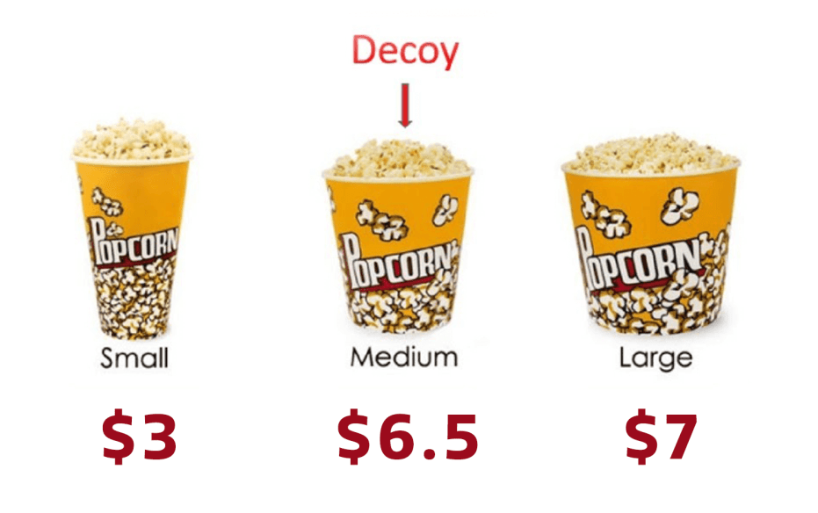
Notes:
When consumers are presented with three products, people are more likely to make the decision between the two similar products. The researcher wondered if this phenomenon also applied to people too?—if there was just one woman in a candidate pool of all men or one person of color in an all white candidate pool, might interviewers make their selection amongst similar candidates and discount the dissimilar candidate?

Slide 5



Slide 6
status quo
effect

Slide 7
COMPOSITION OF FINALIST POOLS
LIKELIHOOD OF HIRING A WOMAN
WOMAN
WOMAN
WOMAN
MAN
67%
WOMAN
WOMAN
MAN
MAN
50%
WOMAN
MAN
MAN
MAN
0%
Source: Stefanie K. Johnson, David R. Hekman, and Elsa T. Chan (2016) “If There’s Only One Woman in Your Candidate Pool, There’s Statistically No Chance She’ll Be Hired” HBR

Slide 8




During 2013-2017 the NFL held interviews for 35 head coaching positions
Black coach hired once
out of 22 positions or 5% of the time
when only one black coach was interviewed
Black coach hired in 4 of 12 positions or 33% of the time
when two black coaches were interviewed
Source: Stefanie K. Johnson (2018) “What Amazon’s Board Was Getting Wrong About Diversity and Hiring” HBR

Slide 9
“Get two in the pool effect” represents an important first step for overcoming unconscious bias and ushering in the racial and gender balance that we want in organizations.
– Stefanie K. Johnson, David R. Hekman, and Elsa T. Chan

