Slide 1
The Vibrant Index Melanie Harrington, President & CEO Lora McKnight, Director of Operations

Slide 2
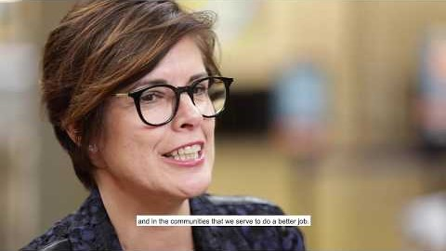
Vibrant Index - The CEO Interviews

Slide 3
Project Rationale: Measure What Matters
Leading indicators = Best practices supported by research
Acknowledge Nudge Change
Build a picture of Pittsburgh’s work environment
Notes:
Why the Vibrant Index?
Organizations will often say: we know that we need to work on diversity and inclusion, but we don’t know what to do or how to begin
Looking at leading indicators: what research-supported best practices can move an organization’s D&I efforts to the next level?
Hoping to begin the journey by Acknowledging Where We Are in our D&I efforts…
Nudge organizations in the right direction by exposing them to Best Practices
Change organizational behavior through feedback and assistance
Through this, get a sense of the Pittsburgh region’s overall work environment when it comes to D&I practices

Slide 4
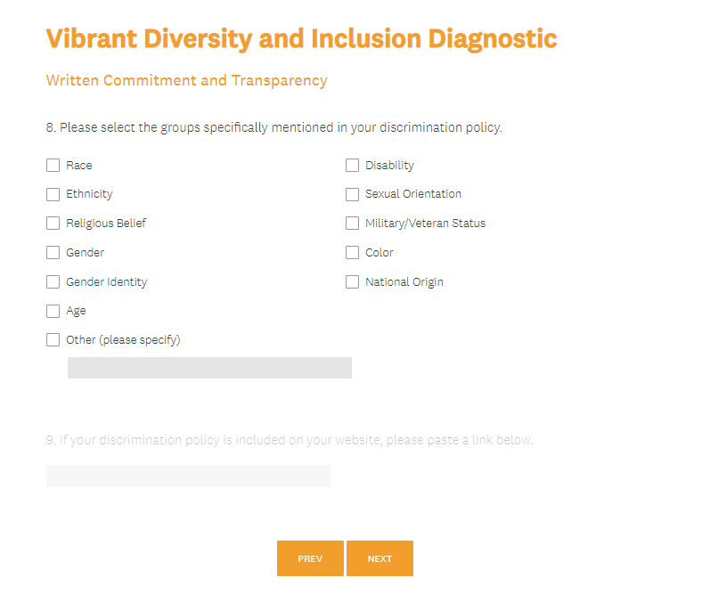
Components: Diversity and Inclusion Diagnostic
Notes:
The Diagnostic is a supportive and confidential tool designed to assist employers in advancing their diversity and inclusion efforts and gather data on regional employer practices
Eligible companies use the Vibrant Diversity and Inclusion Diagnostic tool to indicate which best practices they follow.
Each of the best practices included in the Diagnostic Tool was chosen based on research into diversity and inclusion, and the list was vetted by scholars in the field. They are broken into nine categories:
Written Commitment and Transparency
Benefits and Policies
Employee Networks
Diversity and Leadership
Training and Education
Accountability Metrics
Talent Engagement and Recruitment
Supplier Diversity
Community Engagement

Slide 5
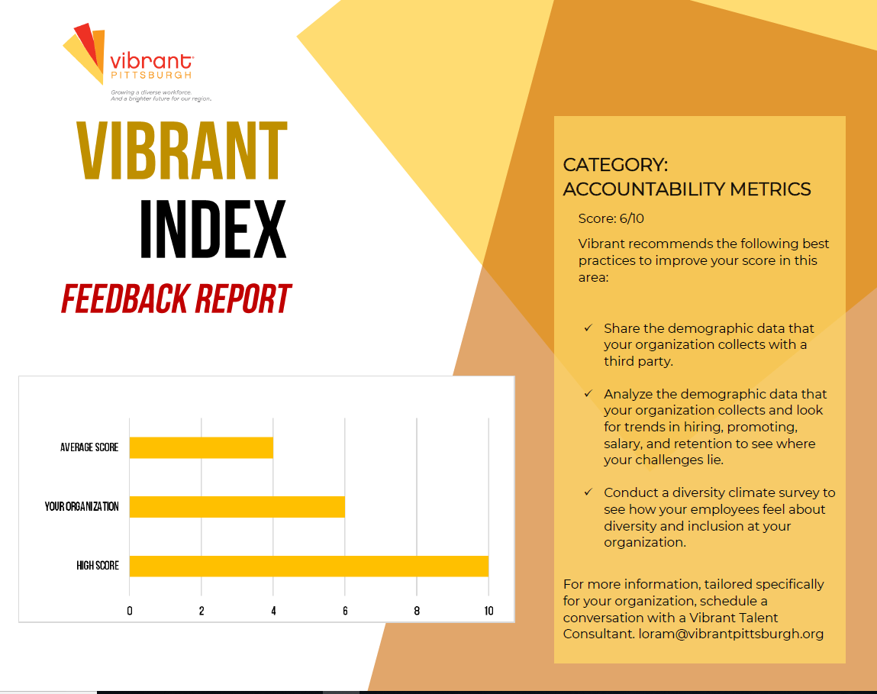
Components: Feedback Report and Vibrant Champions
Notes:
Feedback report incorporates:
Individual organization score
Average organization score
High score
Bespoke ecommendations for improving score in this area
Vibrant Champions are those employers who excel at using best practices and will be given special acknowledgement

Slide 6
Components: Vibrant Talent Consultants
Customized advisory services to foster a more welcoming, inclusive and diverse workplace.
Workplace culture studies
Diversity, equity, and inclusion strategic plans
Outreach and mentoring programs for underrepresented candidates
Policy and procedure reviews
Talent engagement programming
Talent elevation programming
Coaching for mid-level leaders around retention of multicultural talent
Learning plans to address cultural and bias awareness
Diversity, equity and inclusion education
Notes:
All organizations will have access to a Vibrant Talent Consultant to receive an in-depth assessment of their practices or help instituting new strategies or policies to further their D&I objectives.

